Slide 1
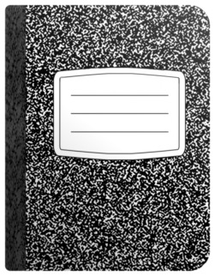
2016 2017
Mrs. Kala Schlaegel
Website: http://kalaschlaegel.weebly.com email: kalaschlaegel@misdmail.org Room: 230
We will learn about the history of the United States from its early beginnings to the present, with a focus on colonial times through the 20th century. Historical content includes explorers, the Colonial and Revolutionary periods, U.S. Government, Westward Expansion, the Civil War, Reconstruction, and 20th and 21st century America.
Interactive Notebooks will be used on a daily basis. They will be stored in the classroom, but can be taken home as needed.
Test Retakes: Students who fail a major test/ assessment (below 70%) will be allowed to correct up to a grade of 70. These arrangements must be made with the teacher.
Corrections: All corrections must be completed prior to the end of each six weeks.
Late Work:
1 class day late, grade reduced by 15 points
2 class days late, grade reduced by 30 points
3 class days late, teachers discretion
*Exceptions to this can be given due to specific student modifications and accommodations
3-Ring binder with AVID materials
I will update my teacher webpage weekly. Please check on a regular basis.
Check out http://www.mansfieldisd.org for course and calendar information.
You can also email me with any questions.
Devices may be used in class with teacher permission.
If you have a smartphone please download these free apps
Materials
Homework
10%
Text Book: The United States & History Alive
Atlases, Almanacs, Various historical materials, and Primary sources
The Library @DSIS:
http://www.mansfieldisd.org/schools/dshepard/school_library/library.htm
Online databases:
Username: shepard Password: mustangs
Daily Work & Quizzes
50%
40%
Tests
There will be more apps that you will need to download later

